Slide 1




Barium Tagging in Solid Xenon for nEXO
Tim Walton
PhD Defense
2015-12-08
committee:
William Fairbank Robert Wilson
Bruce Berger Alan Van Orden

Slide 2
Outline
Neutrinos and neutrinoless double beta decay
EXO-200 experiment
nEXO and barium tagging
Barium tagging in solid xenon (SXe):
Part 1: Spectroscopy of Ba and Ba⁺ in SXe
Excitation/emission of Ba in SXe
Temperature dependence
Bleaching
Candidate Ba⁺ lines
Part 2: Imaging Ba atoms in SXe in focused laser
Images of ~10³ atoms w/ 577- and 591-nm lines
Single-atom level imaging w/ 619-nm line

Slide 3
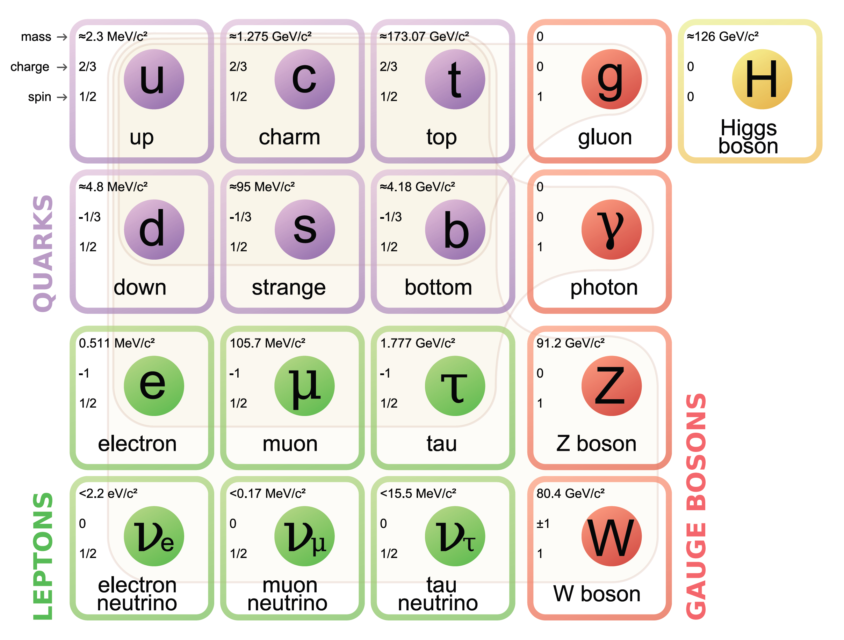
Neutrinos in the Standard Model
Very small mass
Interact only via weak force (and gravity)

Slide 4
Neutrinos in the Standard Model
Charged particles
Distinct
anti-particles
No electric charge
Distinct
anti-particles??
Neutrinos could be Majorana particles, where particle = anti-particle

Slide 5
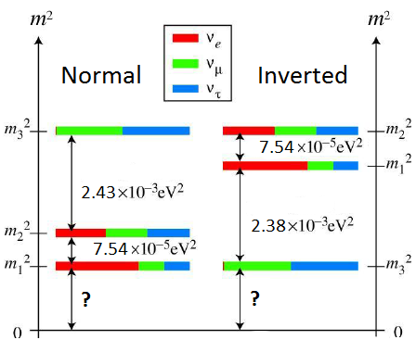
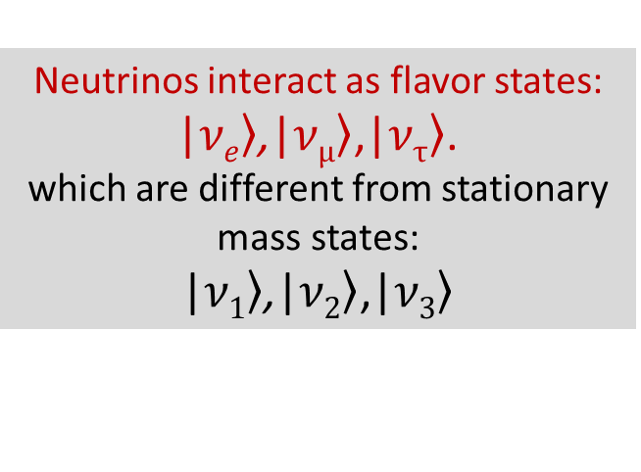
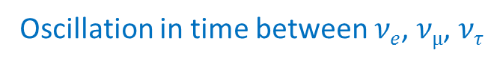
Neutrino Oscillation: neutrinos have mass!
(2015 Nobel prize)
Oscillation in time between $νe$, $νµ$, $ντ$
Neutrinos interact as flavor states: |$\left.νe\right\rangle$,|$\left.νμ\right\rangle$,|$\left.ντ\right\rangle$.
which are different from stationary mass states:
|$\left.ν1\right\rangle$,|$\left.ν2\right\rangle$,|$\left.ν3\right\rangle$
Two possible neutrino mass hierarchies:
Different masses oscillations
Oscillation experiments have measured difference between squares of neutrino masses:
Absolute mass scale yet unknown

Slide 6
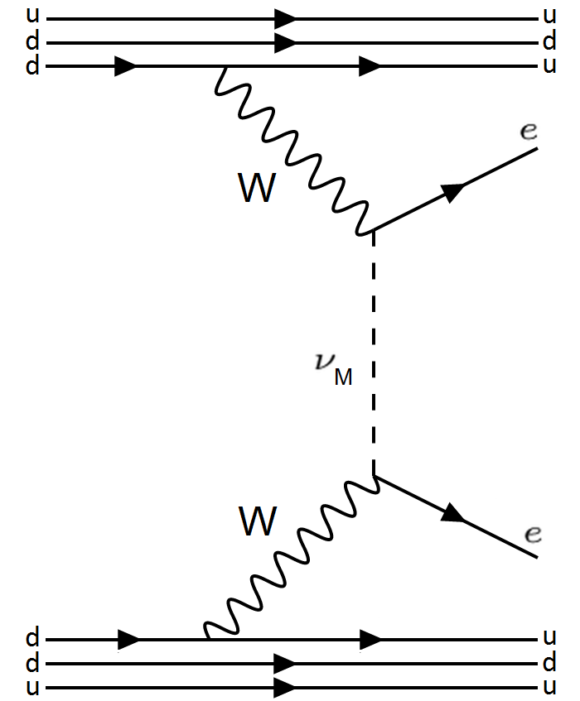
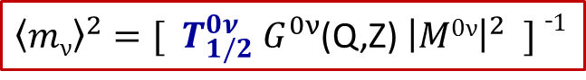
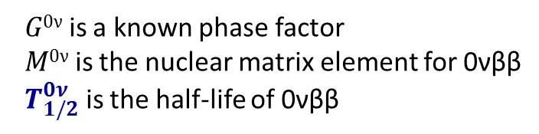
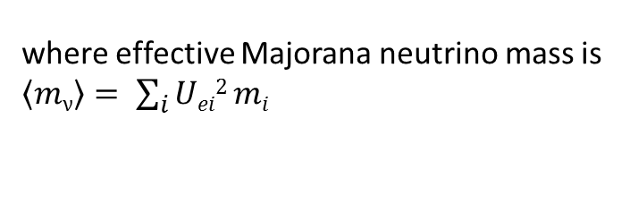
Neutrinoless Double Beta Decay (0νββ)
Observation would demonstrate Majorana nature of neutrinos
Violates lepton number conservation
Could provide measurement of absolute neutrino mass:
${\left\langle mν\right\rangle }^{2}=[{ T}_{1/2}^{0ν}{ G}_{}^{0ν}$(Q,Z) ${\left|M0ν\right|}^{2} ] ¯1$
where effective Majorana neutrino mass is $\left\langle mν\right\rangle = \sum_{i}{Uei2 mi}$
$G0ν$ is a known phase factor
$M0ν$ is the nuclear matrix element for 0νββ
${ T}_{1/2}^{0ν}$ is the half-life of 0νββ

Slide 7
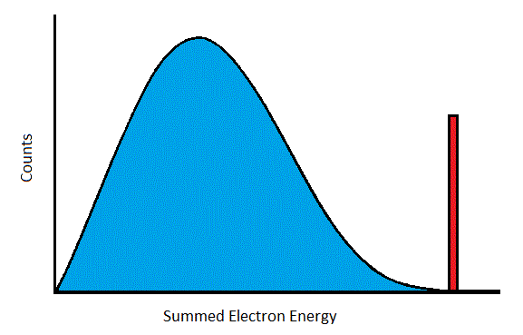
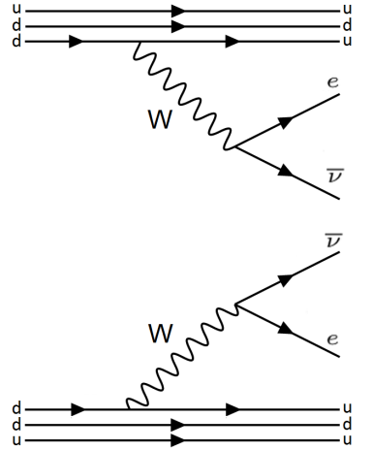

Search for 0νββ
2νββ
Energy Spectrum Signature
0νββ
e
e
- Predicted by Standard Model
- Observed in many isotopes,
including Xe¹³⁶ in EXO
and KamLAND ZEN
Very rare decay
Very low backgrounds are required

Slide 8
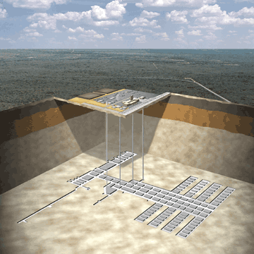
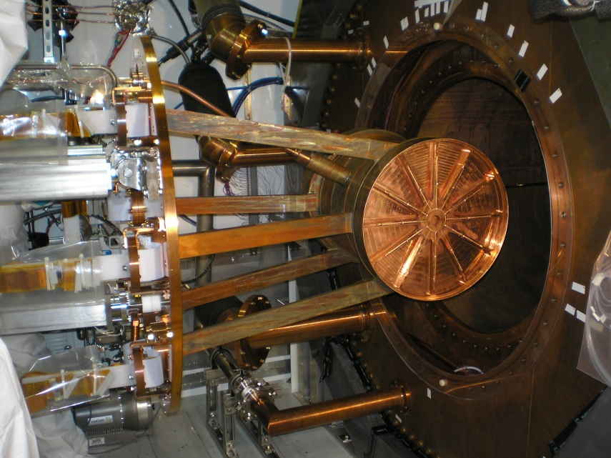
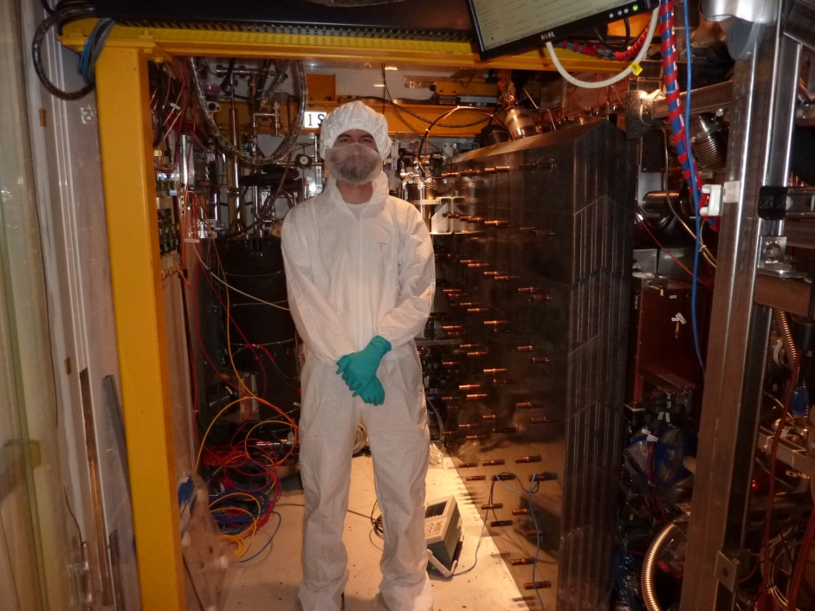
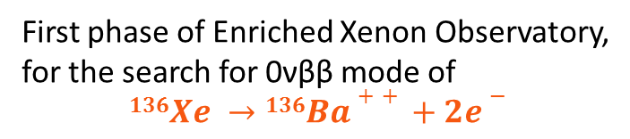
EXO-200
WIPP salt mine
near Carlsbad, NM
First phase of Enriched Xenon Observatory,
for the search for 0νββ mode of
$$136Xe →136Ba++ +2e−$$
~170-kg. liquid Xe (LXe) time projection chamber (TPC), enriched to ~80.6% Xe¹³⁶
operates in class 100 cleanroom, 2,150 ft. underground
TPC installation into copper cryostat

Slide 9
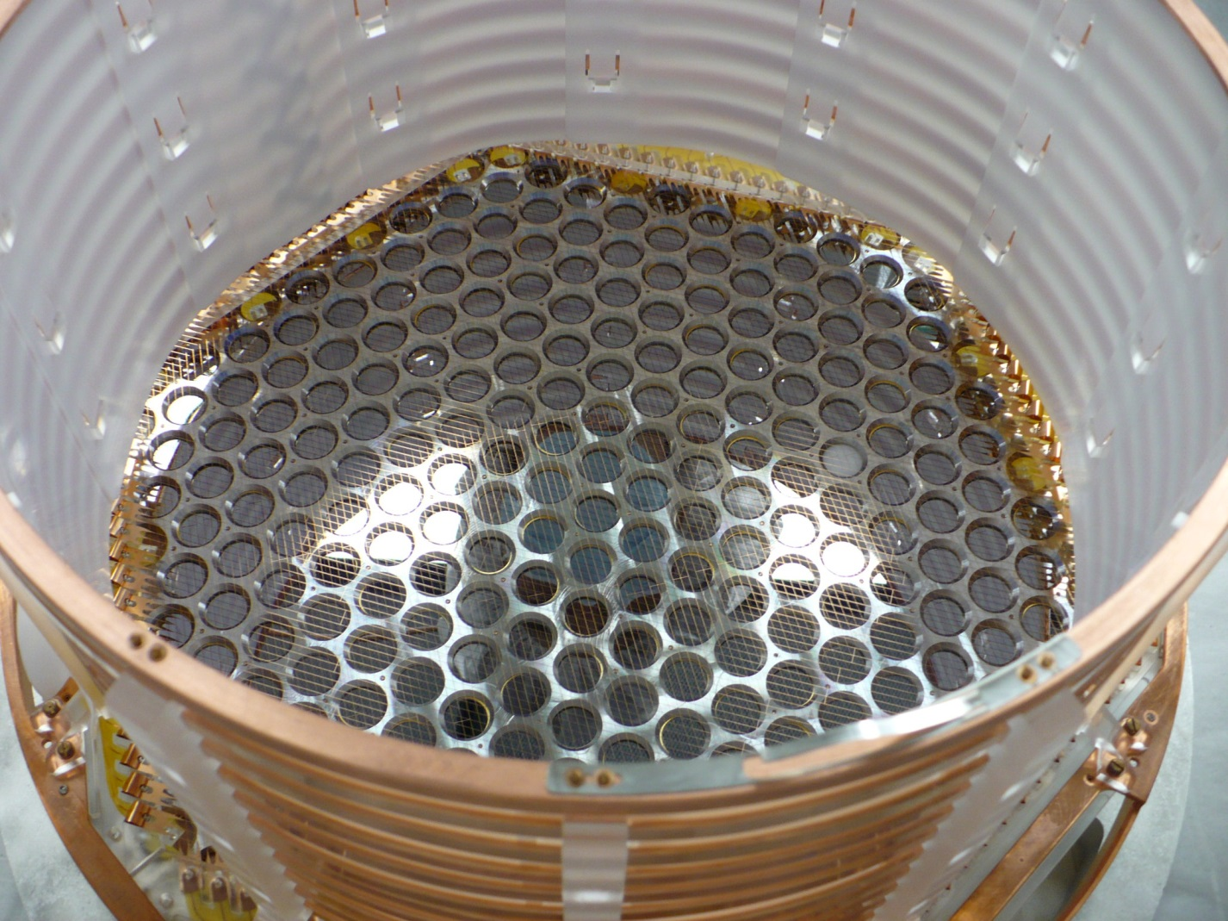
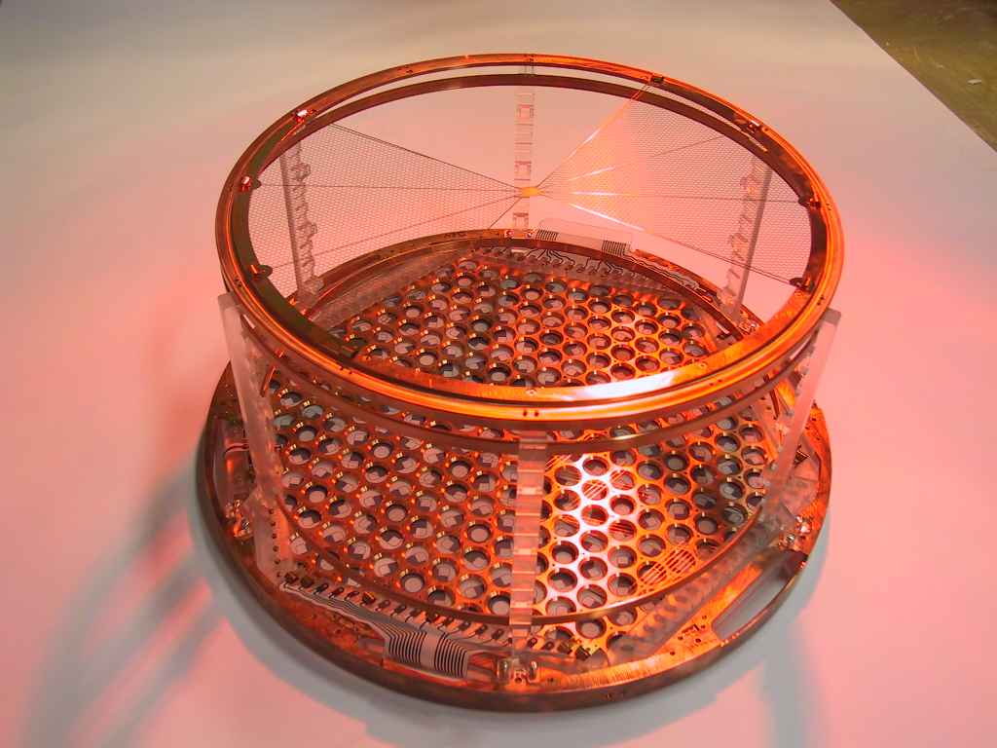
EXO-200 Time Projection Chamber
Cathode grid
Detection plane for
charge (wires) and scintillation
(APDs) from decay events in the LXe

Slide 10
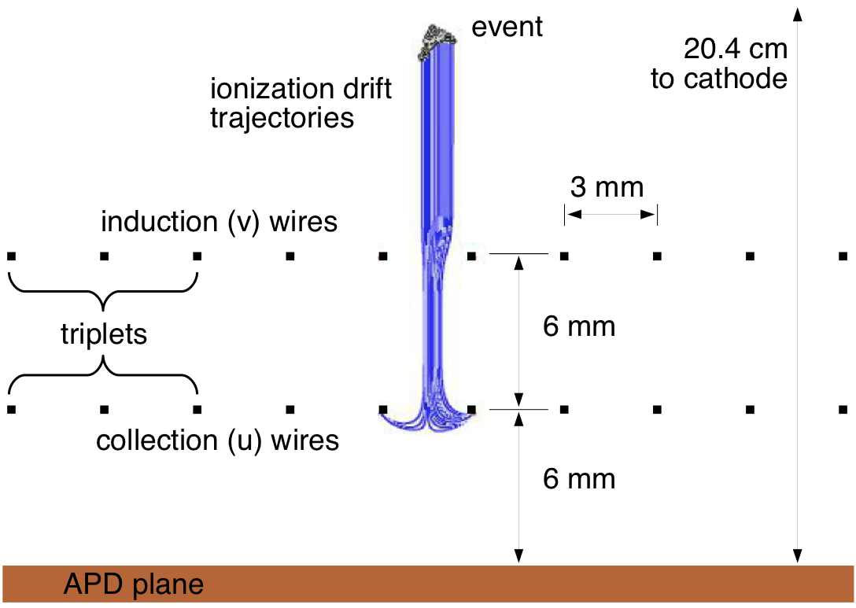
EXO-200 Time Projection Chamber
Liquid Xenon
Cross-hatched “u” and “v” wires give x-y position, u-wires collect ionized charge
Avalanche Photo Diodes (APDs) for scintillation light
Drift time gives z-position
(time between scintillation and charge detection)

Slide 11
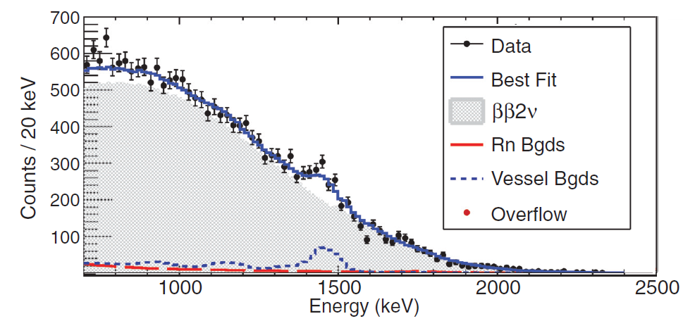
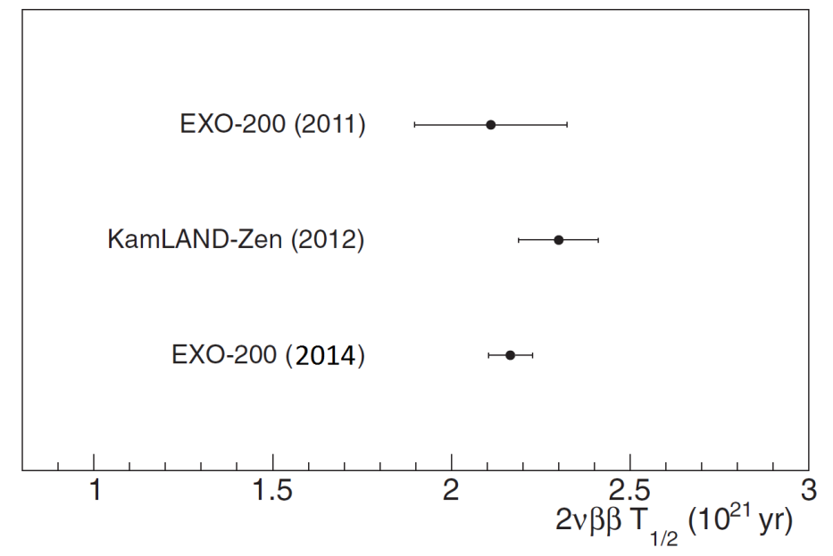
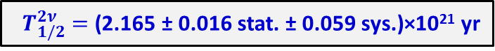
EXO-200 Results: 2νββ Measurement
Phys. Rev. C 89, 015502 (2014)
${ T}_{1/2}^{2ν} =$(2.165 ± 0.016 stat. ± 0.059 sys.)×10²¹ yr

Slide 12
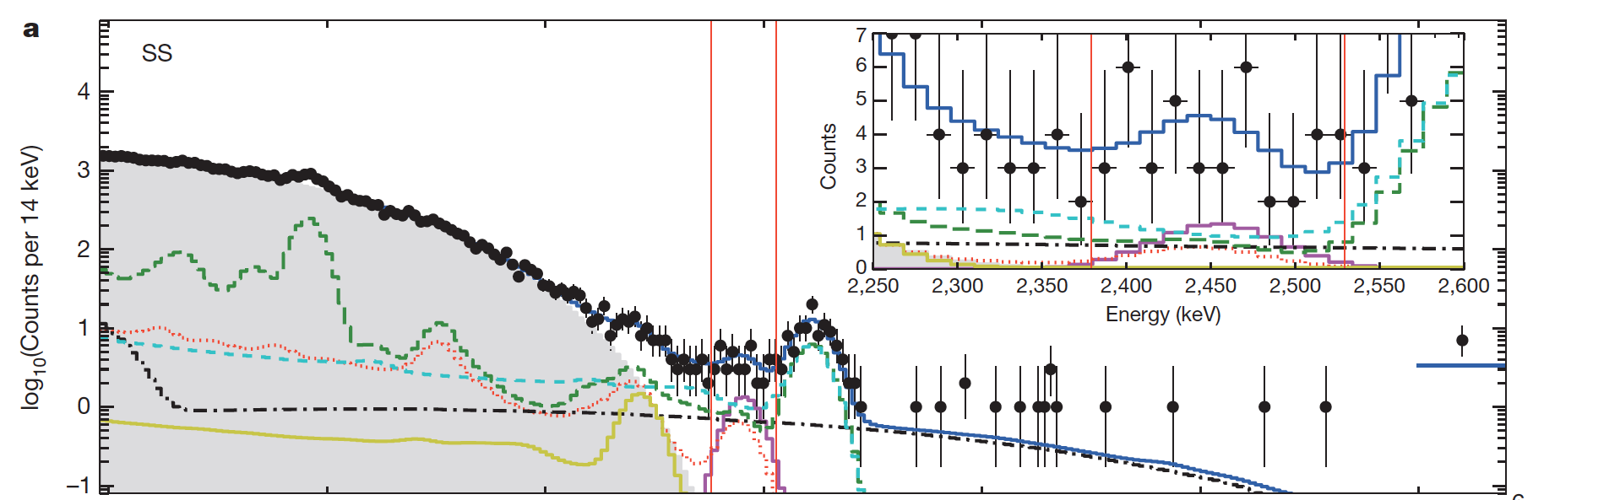
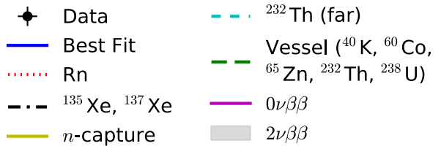
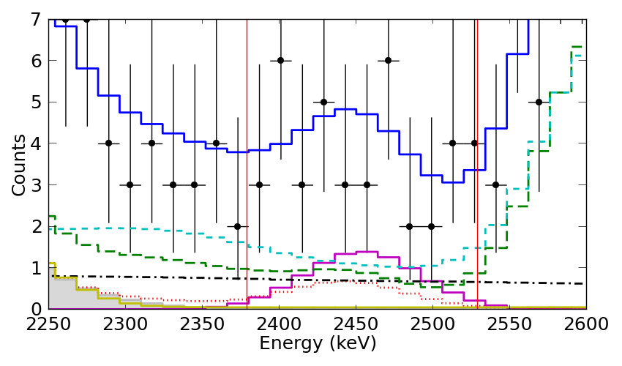
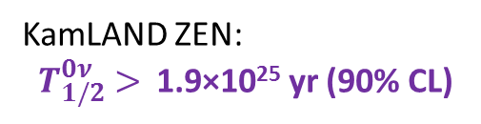
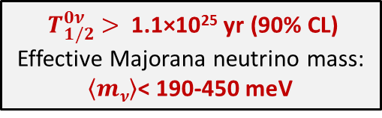
EXO-200 Results: 0νββ Search
2 years of data
Zoom into ±2σ region of interest
# Events from Fit
Backgrounds | 31.1
0νββ decay | 9.9
Total | 41.0
${ T}_{1/2}^{0ν} >$1.1×10²⁵ yr (90% CL)
Effective Majorana neutrino mass:
$\left\langle mν\right\rangle$< 190-450 meV
KamLAND ZEN:
${ T}_{1/2}^{0ν} >$1.9×10²⁵ yr (90% CL)
Nature 510, 229 (2014)

Slide 13
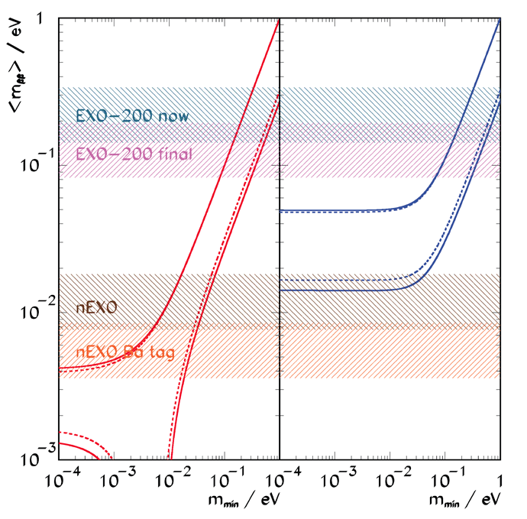
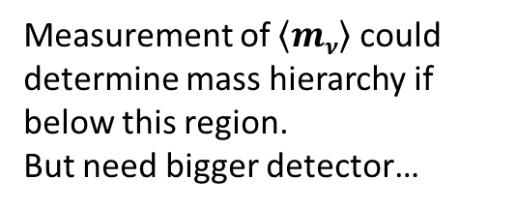
0νββ Sensitivity
Normal Hierarchy
Inverted Hierarchy
Final (2019) EXO-200 sensitivity in “Quasi-degenerate” region of neutrino masses.
Measurement of $\left\langle mν\right\rangle$ could determine mass hierarchy if below this region.
But need bigger detector…

Slide 14
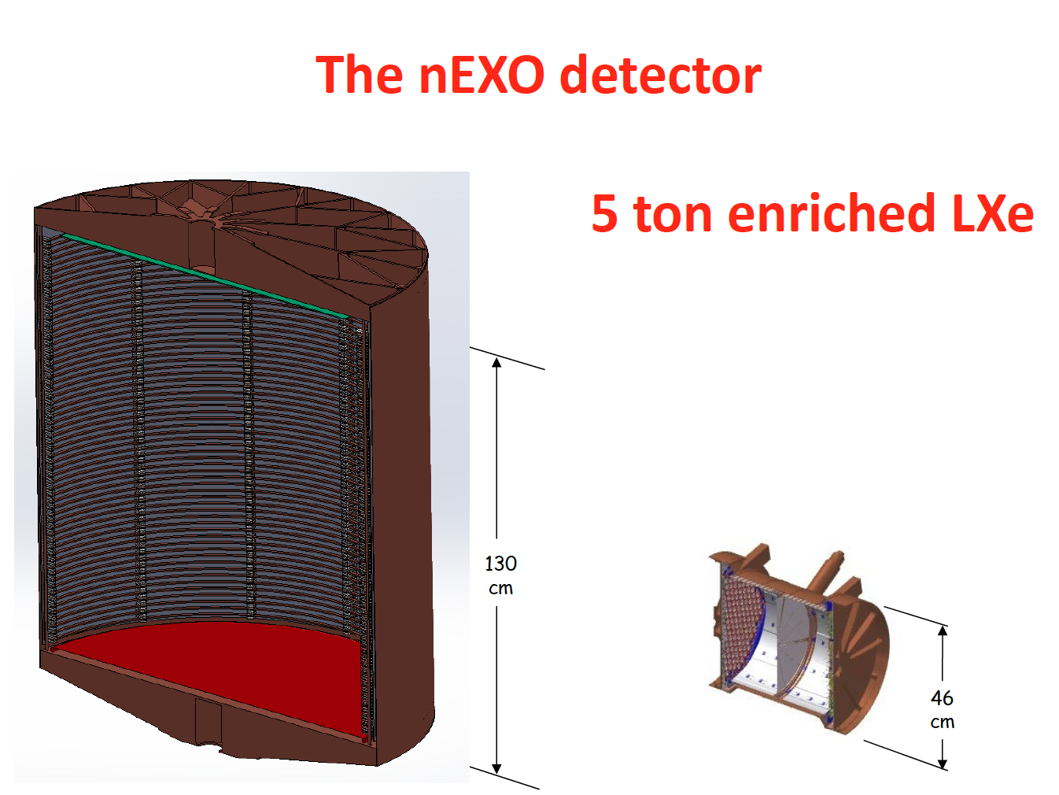
nEXO
Successor to EXO-200: ~5-ton enriched LXe TPC for more sensitive 0νββ search.
EXO-200: 170 kg enriched LXe

Slide 15
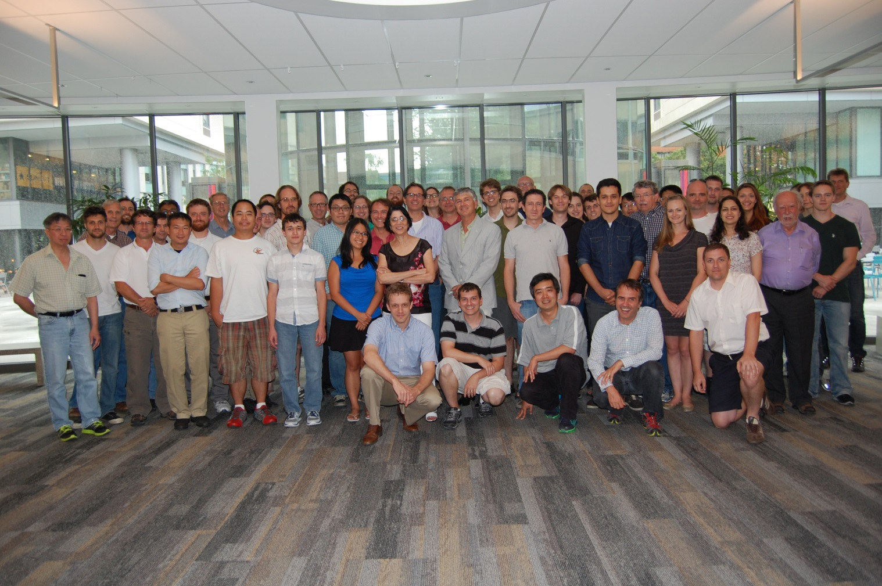








University of Alabama, Tuscaloosa AL, USA — T Didberidze, M Hughes, A Piepke, R Tsang
University of Bern, Switzerland — S Delaquis, R Gornea†, J-L Vuilleumier †Now at Carleton University
Brookhaven National Laboratory, Upton NY, USA — M Chiu, G De Geronimo, S Li, V Radeka, T Rao, G Smith, T Tsang, B Yu
California Institute of Technology, Pasadena CA, USA — P Vogel
Carleton University, Ottawa ON, Canada — Y Baribeau, V Basque, M Bowcock, M Dunford, M Facina, R Gornea, K Graham,
P Gravelle, R Killick, T Koffas, C Licciardi, K McFarlane, R Schnarr, D Sinclair
Colorado State University, Fort Collins CO, USA — C Chambers, A Craycraft, W Fairbank Jr., T Walton
Drexel University, Philadelphia PA, USA — MJ Dolinski, YH Lin, E Smith, T Winick, Y-R Yen
Duke University, Durham NC, USA — PS Barbeau, G Swift
University of Erlangen-Nuremberg, Erlangen, Germany — G Anton, R Bayerlein, J Hoessl, P Hufschmidt, A Jamil, T Michel, T Ziegler
IBS Center for Underground Physics, Daejeon, South Korea — DS Leonard
IHEP Beijing, People’s Republic of China — G Cao, W Cen, X Jiang, H Li, Z Ning, X Sun, T Tolba, W Wei, L Wen, W Wu, J Zhao
University of Illinois, Urbana-Champaign IL, USA — D Beck, M Coon, J Walton, L Yang
Indiana University, Bloomington IN, USA — JB Albert, S Daugherty, TN Johnson, LJ Kaufman, G Visser, J Zettlemoyer
University of California, Irvine, Irvine CA, USA — M Moe
ITEP Moscow, Russia — V Belov, A Burenkov, M Danilov, A Dolgolenko, A Karelin, A Kobyakin, A Kuchenkov, V Stekhanov,
O Zeldovich
Laurentian University, Sudbury ON, Canada — B Cleveland, A Der Mesrobian-Kabakian, J Farine, B Mong, U Wichoski
Lawrence Livermore National Laboratory, Livermore CA, USA — O Alford, J Brodsky, M Heffner, G Holtmeier, A House, M Johnson,
S Sangiorgio
University of Massachusetts, Amherst MA, USA — J Dalmasson, S Feyzbakhsh, S Johnston, J King, A Pocar
McGill University, Montreal PQ, Canada — T Brunner
Oak Ridge National Laboratory, Oak Ridge TN, USA — L Fabris, D Hornback, RJ Newby, K Ziock
Rensselaer Polytechnic Institute, Troy NY, USA — E Brown
SLAC National Accelerator Laboratory, Menlo Park CA, USA — T Daniels,- K Fouts, G Haller, R Herbst, M Kwiatkowski,
K Nishimura, A Odian, M Oriunno, PC Rowson, K Skarpaas
University of South Dakota, Vermillion SD, USA — R MacLellan
Stanford University, Stanford CA, USA — R DeVoe, D Fudenberg, G Gratta, M Jewell, S Kravitz, D Moore, I Ostrovskiy, A Schubert,
K Twelker, M Weber
Stony Brook University, SUNY, StonyBrook, NY, USA — K Kumar, O Njoya, M Tarka
Technical University of Munich, Garching, Germany — P Fierlinger, M Marino
TRIUMF, Vancouver BC, Canada — J Dilling, P Gumplinger, R Krücken, F Retière, V Strickland
The nEXO Collaboration

Slide 16
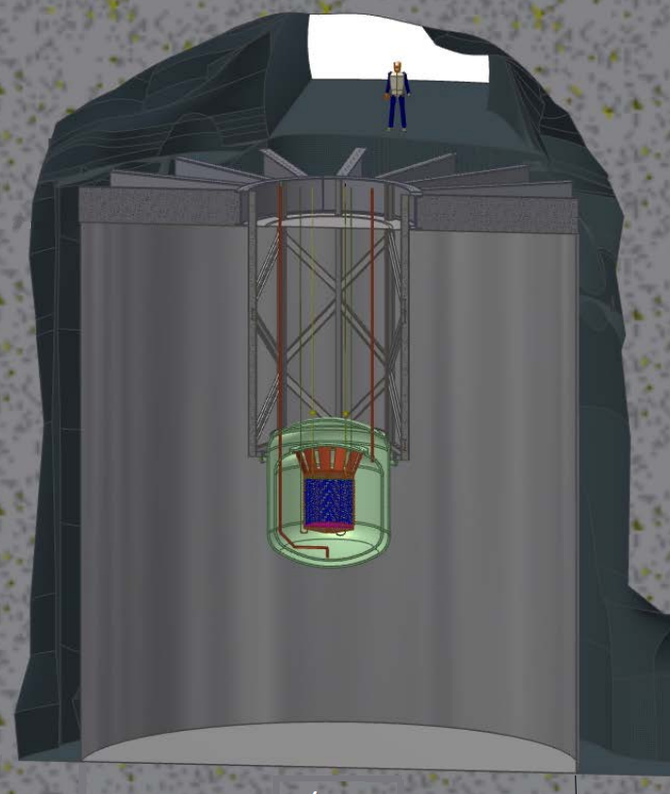
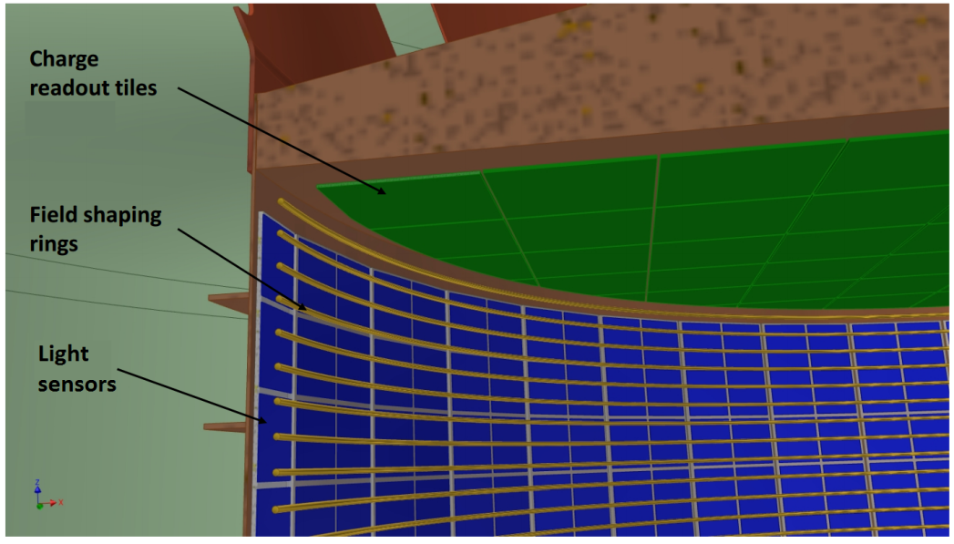
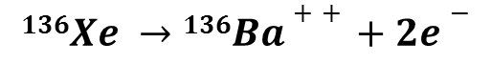
nEXO
Successor to EXO-200: ~5-ton enriched LXe TPC for more sensitive 0νββ search.
Ba tagging: identify barium daughter for complete background elimination
$$136Xe →136Ba++ +2e−$$
Will require grabbing/detecting a single Ba⁺ out of a macroscopic volume of LXe!

Slide 17
0νββ Sensitivity
Normal Hierarchy
Inverted Hierarchy
nEXO will probe entire Inverted Hierarchy, and well into Normal Hierarchy with Ba tagging.

Slide 18
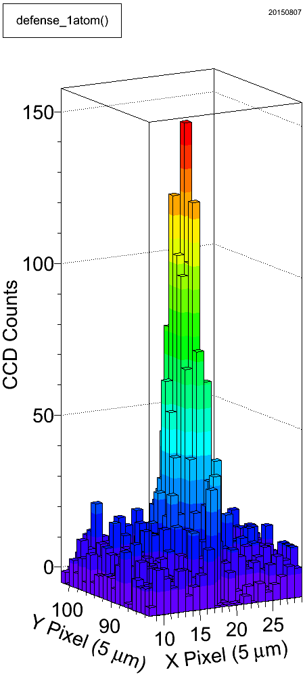
Barium Tagging in Solid Xenon
laser
fiber
Cold probe
≤ 1 Ba atom in SXe in focused laser
CCD
liquid Xe TPC
solid Xe
Ba⁺ ion
Oνββ decay
Ba⁺⁺ → Ba⁺ expected in LXe
Ba⁺ ion
solid Xe

Slide 19
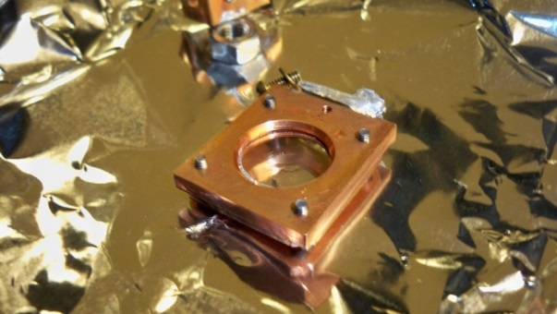
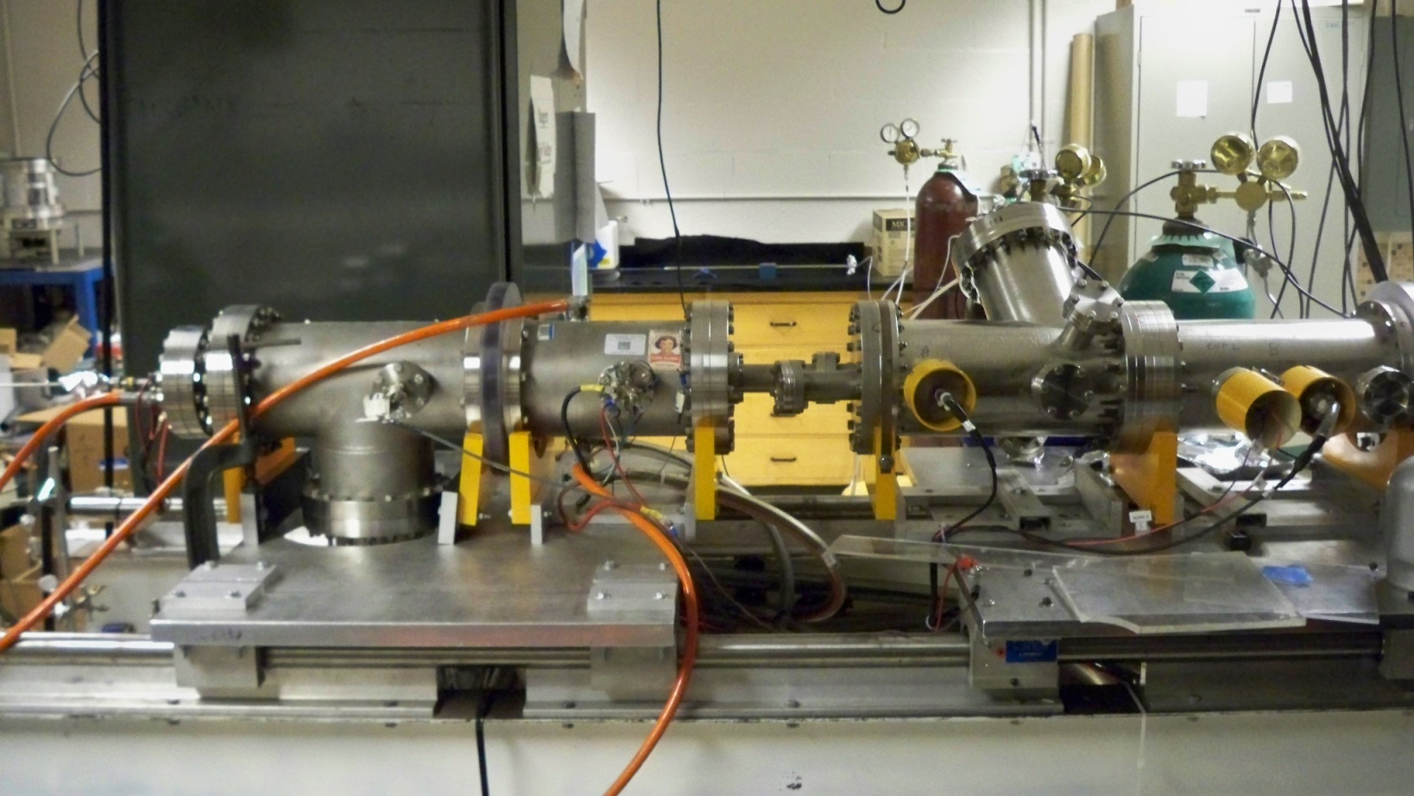
Ion Beam
for depositing Ba⁺ ions into Solid Xenon
Ba⁺ ion
source
2000 V
EхB
mass filter
pulsing
plates
Sapphire
Window
Faraday cup
Faraday cup
Decelerator
deflection
plates
deflection
plates
deflection
plates
Einzel Lens
Acceleration/
Einzel Lens
Einzel Lens
induction plates

Slide 20
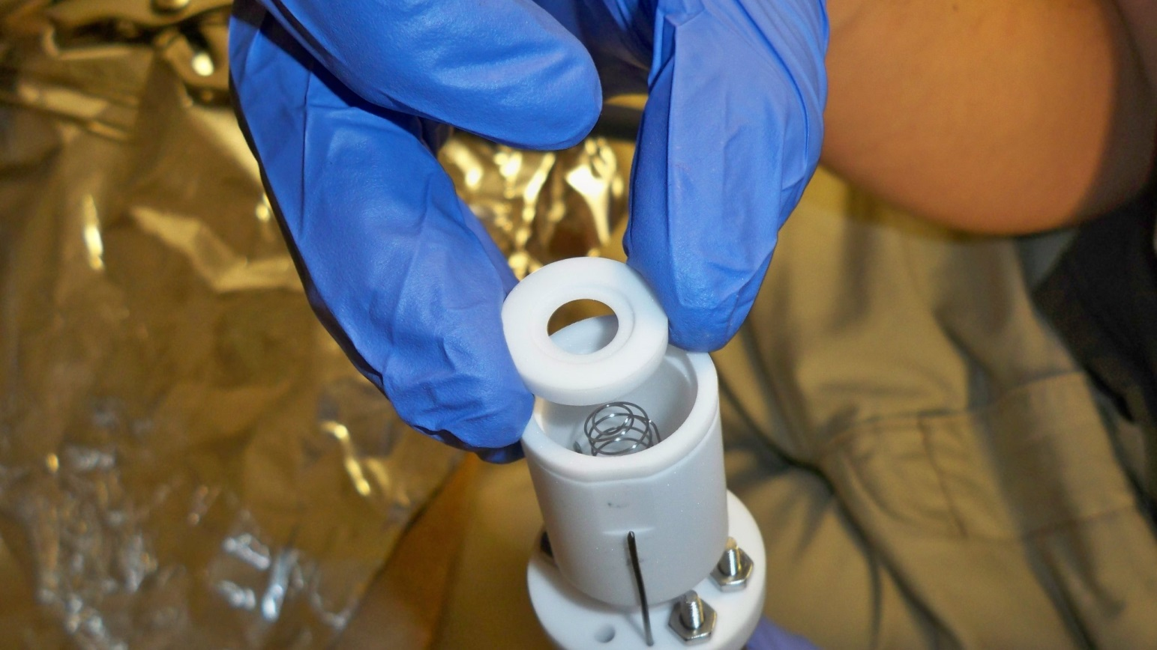
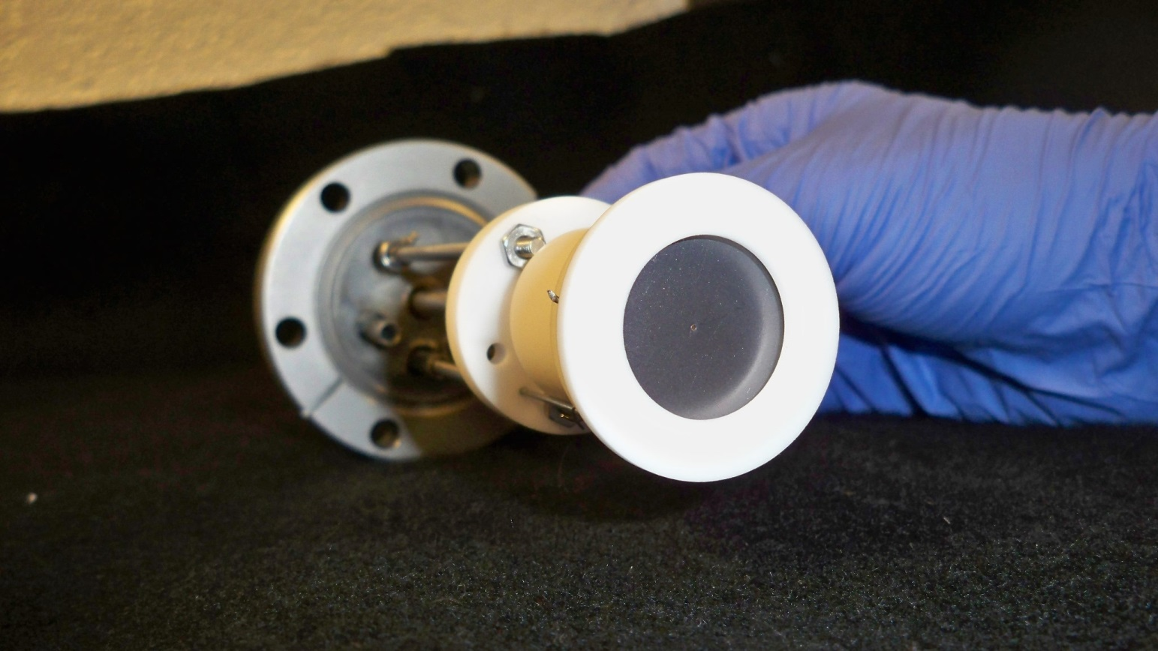
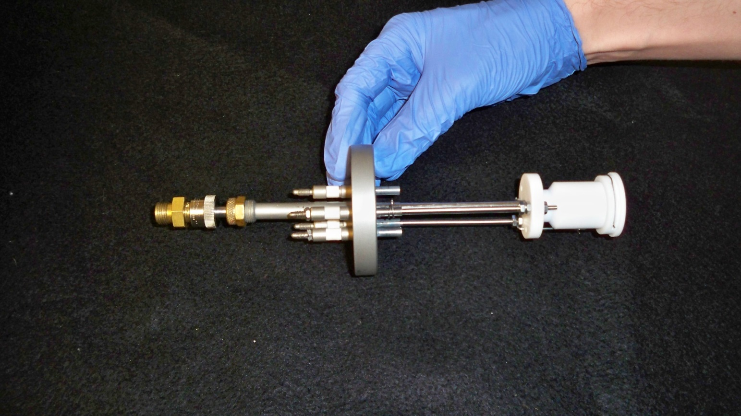
Ion Source
hot filament/cathode
Barium source
Ba+ ions
anode

Slide 21
E x B Mass Filter for selecting Ba⁺
N
Only ions with velocity satisfying
qE = qvB
will move through filter undeflected, thus selecting specific m/q, which have different velocities due to initial acceleration.
ion beam
Electrode “shims” for shaping E-field
-
+
S

Slide 22

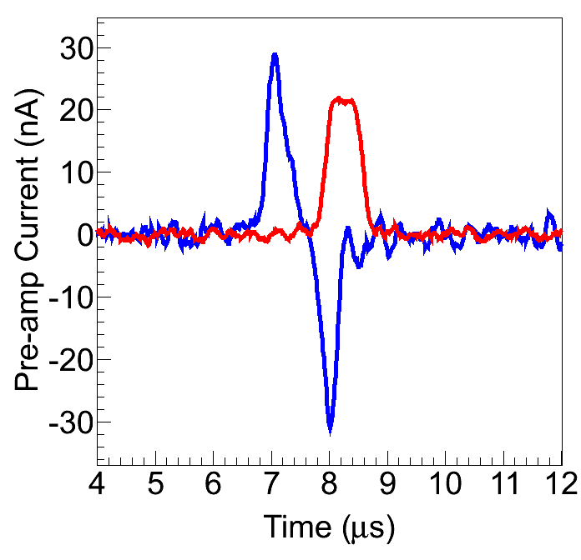
Ba⁺/Ba Deposition
Induction Plates
Pulsed Ba⁺
Ion Beam
Faraday Cup
Sapphire Window (11 K)
Faraday cup is calibrated to calculate
Ions/Area
Pulse

Slide 23
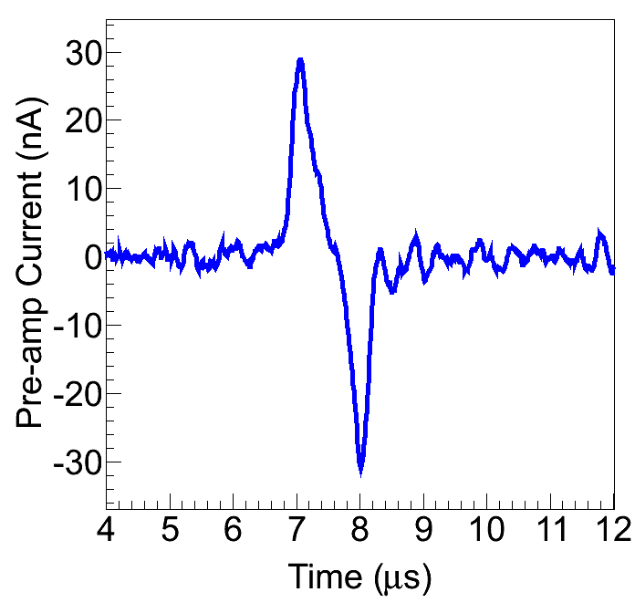
Ba⁺/Ba Deposition
Xe gas
Induction Plates
Pulsed Ba⁺
Ion Beam
Sapphire Window (11-50 K)
Retract Faraday cup during Ba⁺ pulse deposit.
Induction signal is read out during deposit.

Slide 24
To spectrometer/CCD
Filter
50 mm Camera Lens
Tunable Dye Laser
Sapphire Window (11 K)

Slide 25
To spectrometer/CCD
Filter
50 mm Camera Lens
Tunable Dye Laser
Sapphire Window (11 K)
Some neutralization of Ba⁺ in SXe

Slide 26
To spectrometer/CCD
Filter
50 mm Camera Lens
Tunable Dye Laser
Sapphire Window (11 K)
Some neutralization of Ba⁺ in SXe
Samples are evaporated by heating sapphire window to 100 K

Slide 27
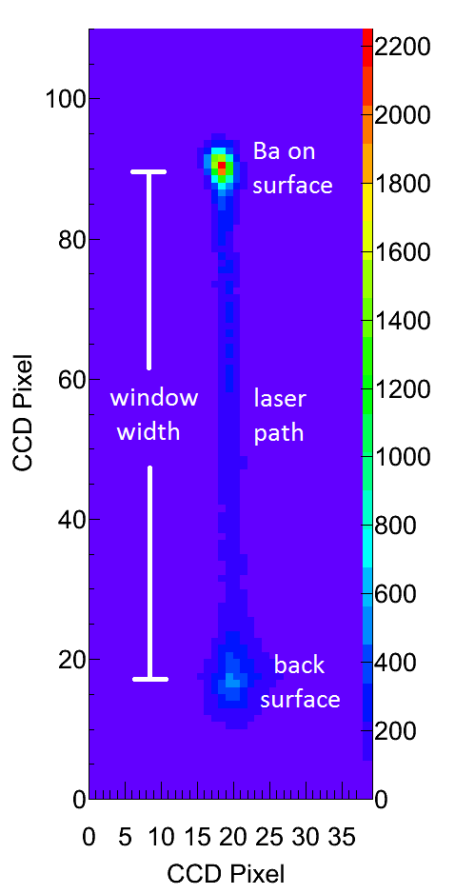
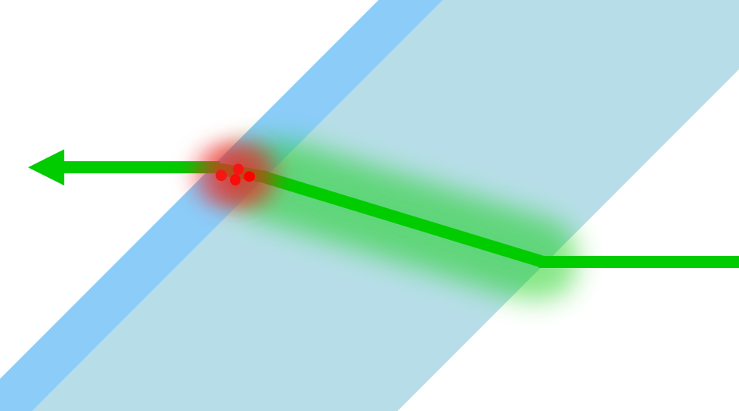
Imaging Ba in SXe on Cold Sapphire Window
Image is from above
cross-sectional side view
Laser
Ba
SXe
Sapphire Window
Laser

Slide 28
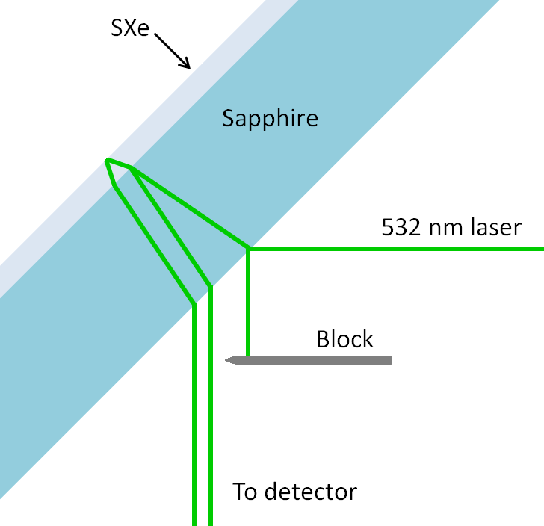
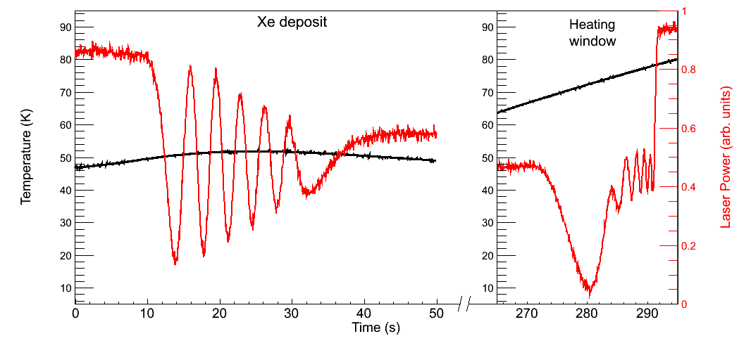
Measuring Xe matrix growth rate using interference fringes:
Xe deposit at 50 K
Observe same number of fringes when evaporating sample
Deposition rate of ~30 nm/s

Slide 29
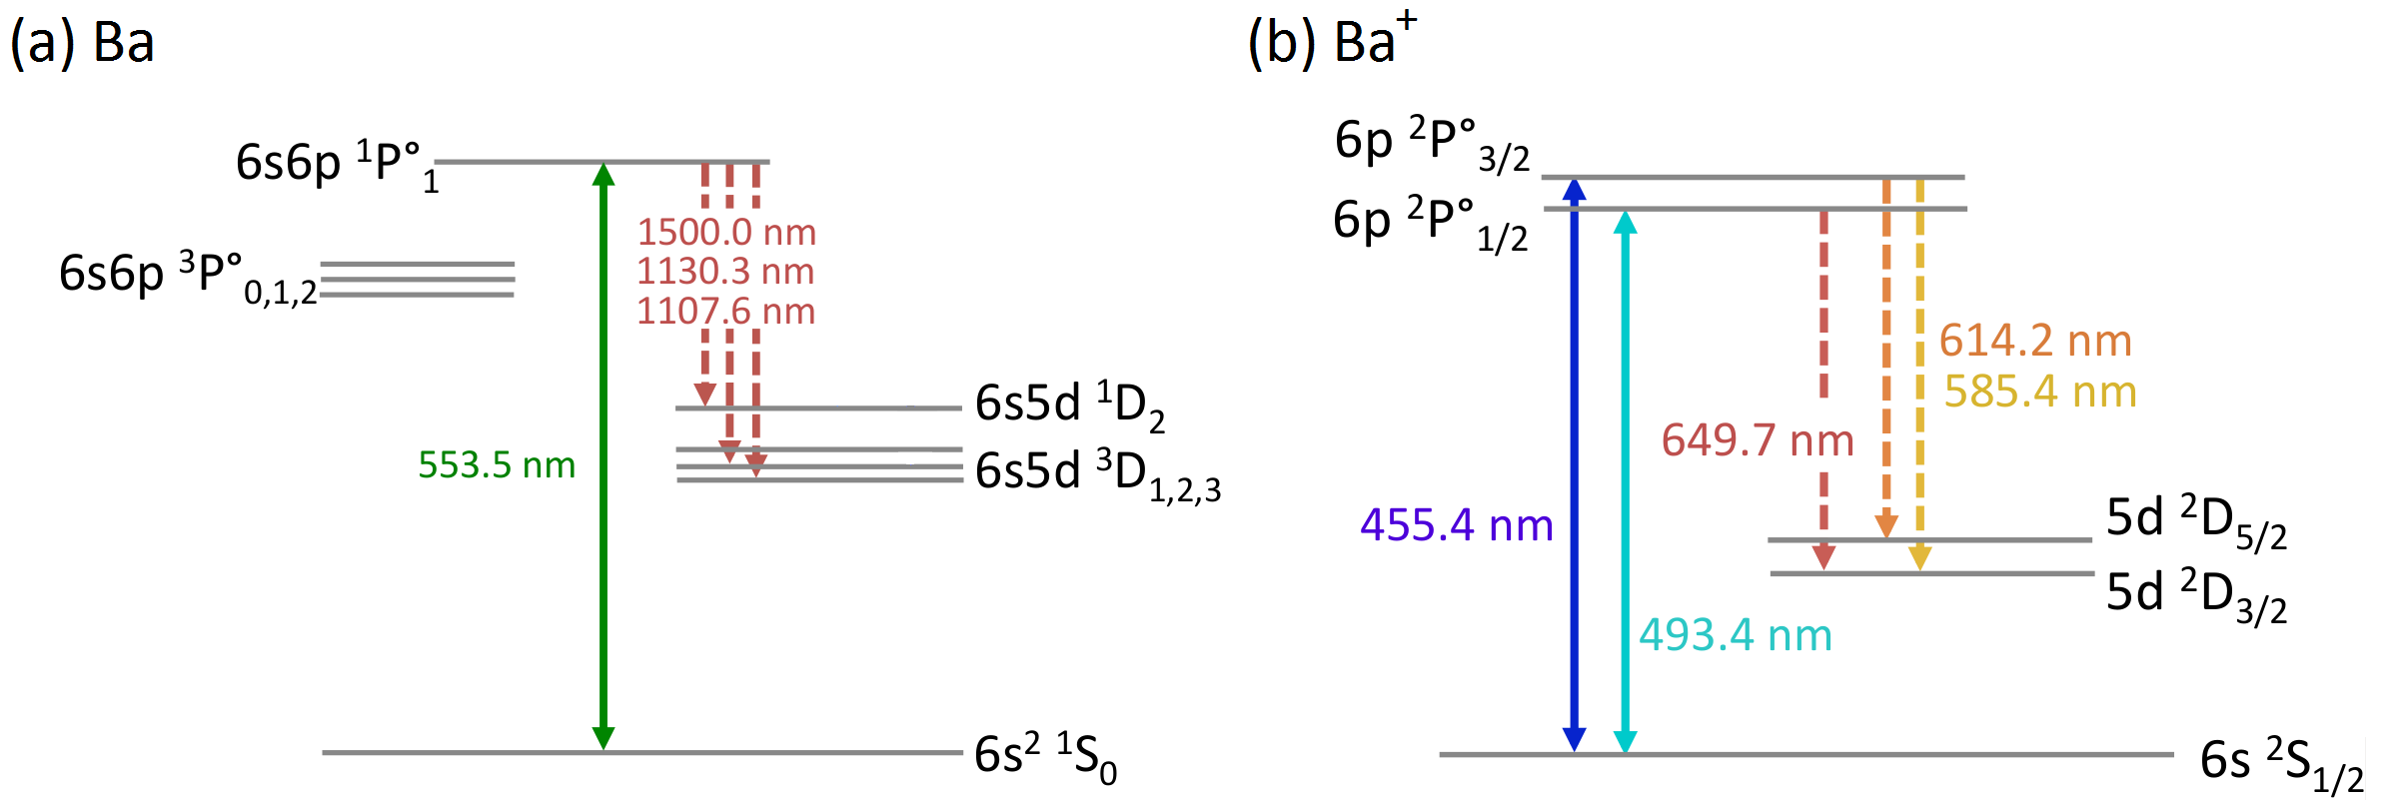
Ba and Ba⁺ Transitions in Vacuum
Ba
Ba⁺
~1 in 330 decays from ¹P₁ state are into metastable D states
~1 in 4 decays from ²P_{1/2} state are into metastable D state

Slide 30
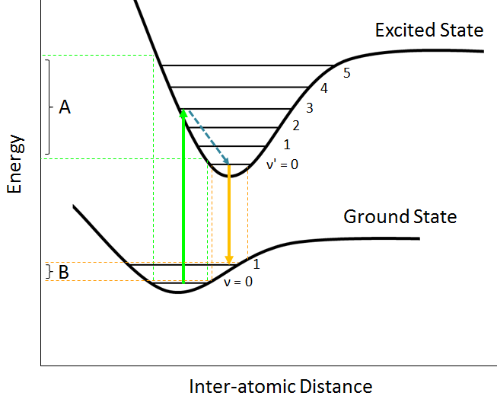
Interactions with neighboring host atoms (xenon)
Ba/Xe interaction is different in ground vs. excited state:
Franck-Condon principle:
Strongest excitation occurs to vibrational states whose wavefunctions overlap
Vibrational states
Shifts and broadening in absorption (A) and emission (B)

Slide 31
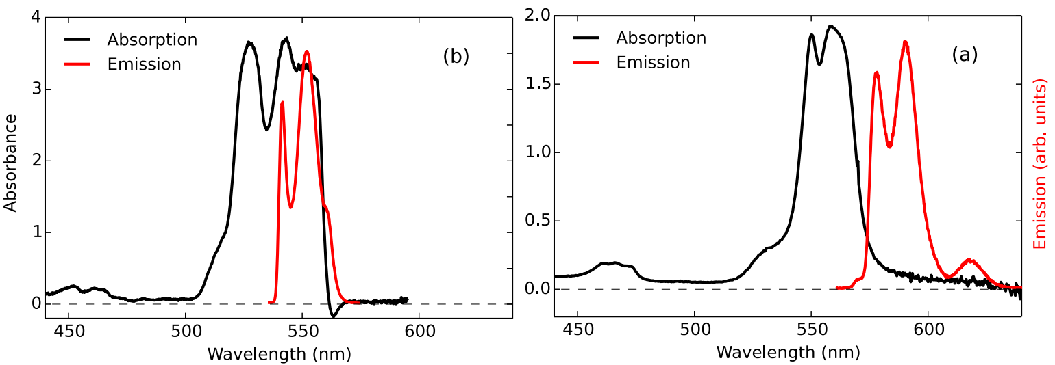
Interactions with neighboring host atoms (xenon)
Ba in solid argon
Ba in solid xenon
Phys. Rev. A 91, 022505 (2015).
Excitation and emission are broadened
Excitation is shifted from vacuum wavelength
Emission is shifted from excitation

Slide 32
Interactions with neighboring host atoms (xenon)
Rate changes:
Non-radiative, e.g. crossing of potential energy curves
Radiative, e.g. parity change

Slide 33
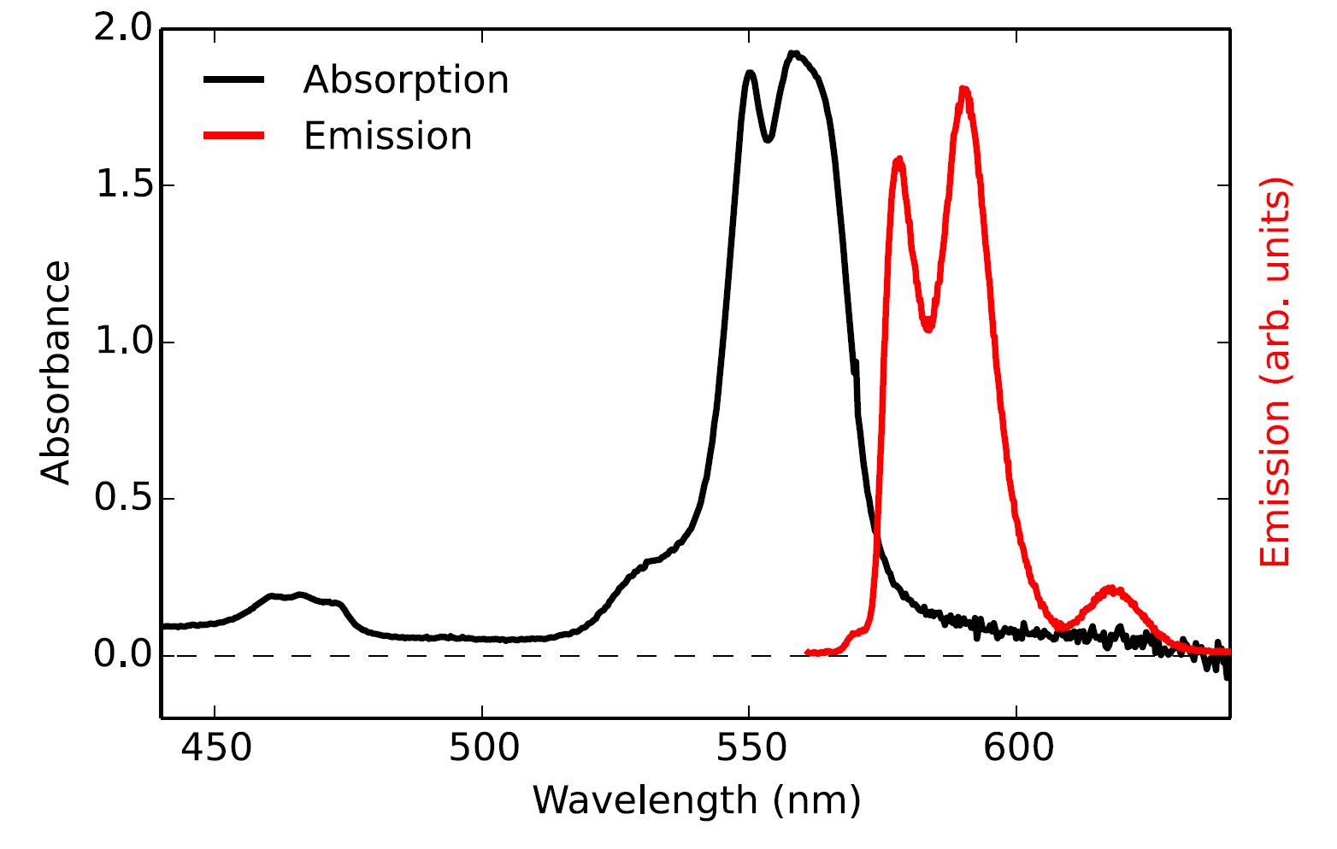
Matrix Sites
Matrix effects (shifts, broadening, and transition rates) can be matrix site dependent.
Ba
Emission from Ba occupying different sites

Slide 34
Part 1: Spectroscopy

Slide 35
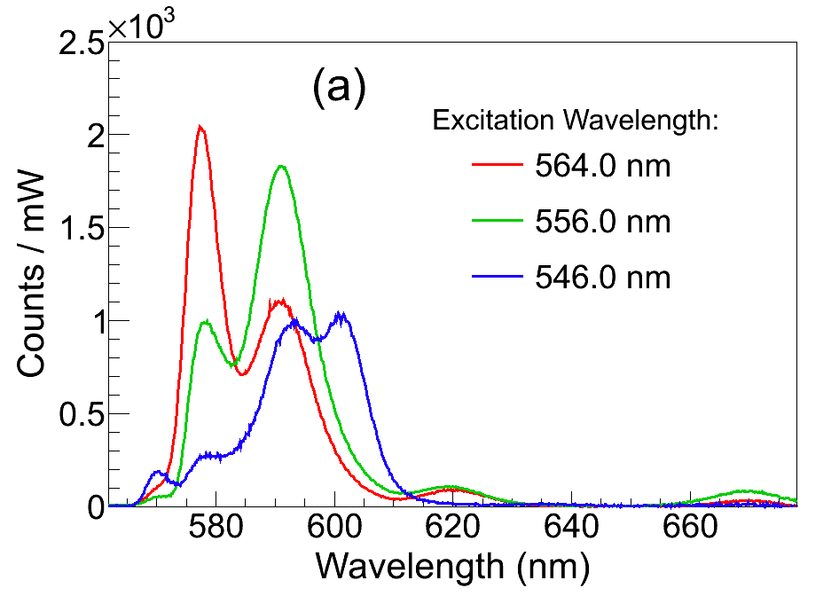
Emission of Ba in Solid Xe
b
c
Peaks observed at:
570 nm
577 nm
591 nm
601 nm
619 nm
670 nm
d
a
e
f

Slide 36
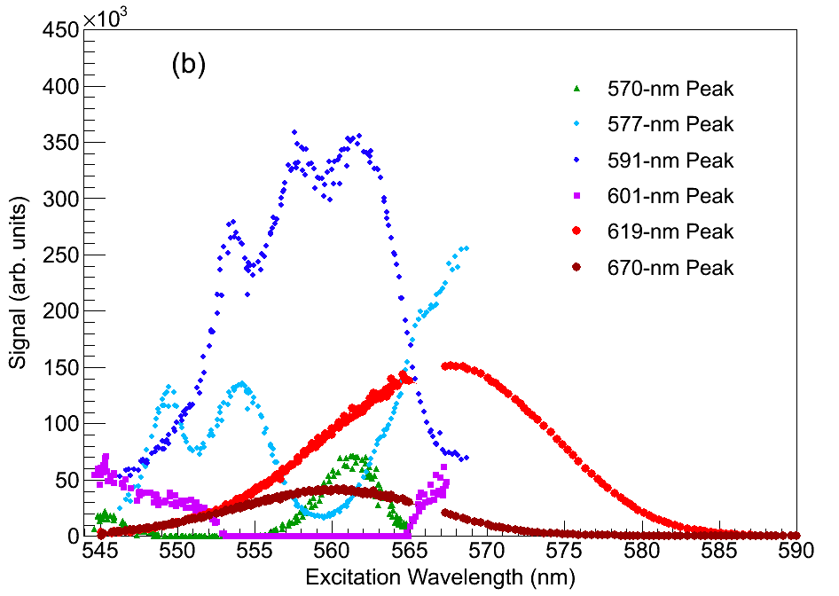
Excitation Spectra of Ba Emission Peaks
Phys. Rev. A 91, 022505 (2015).

Slide 37


Thermal History Dependence
Matrix site populations can depend on thermal history:
to ~40 K
Deposits at higher temperature (50 ± 5 K) result in larger 577-nm and 591-nm.
All observation is at 11 K
Deposit at 11 K
Deposit at 52 K
Images of 619-nm Ba fluorescence in focused laser (discussed later):
619-nm signal also higher w/ 50 ± 5 K deposit.

Slide 38




Annealing
564 nm laser excitation
Gain in 577-nm and 619-nm peaks after Cycle 1 (to 39 K), with modest loss in 591-nm.
Loss in fluorescence after Cycle 3 (to 48 K).
Overall, fluorescence is highest at 11 K.

Slide 39



Bleaching
Decay of Fluorescence w/ Laser Exposure
Spectra of Ba in SXe at different moments in time:
Every tenth exposure shown
556.9 nm Laser
562.6 nm Laser
566.3 nm Laser
1 s exposures
0.2 s exposures
0.2 s exposures
Phys. Rev. A 91, 022505 (2015).
Rapid bleaching in 570-nm, 577-nm, 591-nm peaks.
619-nm and 670-nm peaks do not bleach at this laser intensity

Slide 40


Bleaching
Decay of Fluorescence w/ Laser Exposure
What causes bleaching?
Likely: optical pumping into metastable states, as in Ba in vacuum:
Bleaching is an obstacle for observing single atoms in these matrix sites: need more photons/atom.
591-nm fluorescence,
562.6 nm laser
Re-pumping with IR lasers may be required for continued fluorescence cycle w/ these peaks.
# Excitations

Slide 41



Re-pump Attempts
w/ inexpensive and on-hand Lasers
Higher-level states may provide re-pump paths (in addition to direct IR transitions).
e.g., 659.7 nm used along with 1130.0 nm and 1500.0 nm for
Ba MOT in Phys. Rev. A 79, 041402(R) (2009)
Ba in Vacuum
591-nm fluorescence vs. time w/ and w/o additional lasers:
No positive effect from these additional lasers (only increased bleaching)
Green: 555 nm (dye)
IR: 1064 nm (Nd:YAG)
+ 1550 nm (diode)
Red: 657 nm (diode)
Blue: 473 nm (dye)
Violet: 406 nm (Kr ion laser)

Slide 42


Bleaching of 619-nm Peak
619-nm fluorescence counts from a focused laser:
Much higher excitation rate due to focused laser
# Excitations
Though some bleaching is observed with the higher 0.61 mW laser power, the long-lasting 619-nm fluorescence is intriguing for single-atom detection w/o the need for re-pump lasers…

Slide 43



Blue Excitation: Candidate Ba⁺ Lines
Emission of Ba⁺ deposit w/ 468.25-nm excitation:
Unknown: will some daughters remain ionized?
76% of beta decay daughters of ²¹⁴Pb remain ionized in EXO-200 (Phys. Rev. C 92 (2015))
Remain ionized in SXe on probe?
a
e
f
Ba⁺ in vacuum:
d
b
c
Excitation spectra for emission peaks:
(a)
(b)
(c)
(d)
(e)
(f)
Similarity between excitation spectra for
532 nm line and 635 nm line suggests they are related, and could be fluorescence of P→S and P→D, respectively, for Ba⁺.

Slide 44
Part 2: Imaging

Slide 45
Imaging Ba in SXe on Cold Sapphire Window
Image is from above
cross-sectional side view
Laser
Ba
SXe
Sapphire Window
Laser

Slide 46

Band-pass Filters for Imaging
620-nm band-pass
For 619-nm peak
586-nm band-pass
For 577-nm and 591-nm peaks together

Slide 47







Imaging 591-nm Fluorescence w/ Focused Laser, ~1 mW
50 msec.
100 msec.
200 msec.
700 msec.
~4.5 sec.
~3 min.
Cross-section
at focus position:
These use a 590-nm band-pass filter:
Hole-bleaching occurs rapidly at high laser intensity.
Need to use low laser power to image only atoms within focused laser region.

Slide 48


Imaging 577-nm and 591-nm Fluorescence
w/ Focused Laser (radius w = 5μm), 0.03 µW
≤ 2700 Ba atoms
Frame 1
Frame 3
…
Laser radius w = 5μm
Only slight bleaching at this intensity in 100-s exposures
Backgrounds are negligible at this intensity

Slide 49


Calculating # Ba atoms in focused laser region
Ba⁺ ion pulses:
Due to unknown neutralization fraction
From calibrated Faraday signal
Per pulse of ion beam:
#atoms ≤ #ions = [charge/(1.6×10⁻¹⁹ C)]/m² × Laser Area
Simulated laser spot of radii w_{x} × w_{y} = 2.06μm × 2.66 μm:
Two definitions for number of atoms:
Those instantaneously illuminated by laser spot
8.6 μm²
Total illuminated over vibrations
40 μm²
vibrations
2)
Laser spot size overlain on cryostat vibration data:
μm
μm

Slide 50
Calculating # Ba atoms in focused laser region
Ba⁺ ion pulses:
Due to unknown neutralization fraction
From calibrated Faraday signal
Per pulse of ion beam:
#atoms ≤ #ions = [charge/(1.6×10⁻¹⁹ C)]/m² × Laser Area
Simulated laser spot of radii w_{x} × w_{y} = 2.06μm × 2.66 μm:
Two definitions for number of atoms:
Those instantaneously illuminated by laser spot
8.6 μm²
Total illuminated over vibrations
40 μm²
vibrations
2)
Laser spot size overlain on cryostat vibration data:
μm
μm

Slide 51



Imaging 619-nm Fluorescence
Backgrounds become important at high laser intensity
Image w/ 620-nm
band-pass filter:
Sapphire Emission Spectrum:
Band-pass
Filter
Surface Background Spectrum:
Band-pass
Filter
Broad and sharp emission from Cr³⁺ impurities in sapphire window
Dominant background
Bleaches with laser exposure – can be reduced
Minimized by high-purity windows
Only low tail is passed by filter

Slide 52



Bleaching of the Surface Background
Surface background counts during pre-bleaching process:
~5× reduced

Slide 53
Optimal conditions are determined:
1) Observe 619-nm peak w/ 570 nm laser
Deposit at ~50 K, observe at 11 K
Pre-bleach to lower surface background

Slide 54

Imaging 619-nm Fluorescence
Xe-only deposits are observed in between Ba⁺ deposits to monitor surface background:
Ba signal is clear over background

Slide 55

Imaging 619-nm Fluorescence
Xe-only deposits are observed in between Ba⁺ deposits to monitor surface background:
Ba signal is clear over background

Slide 56

Imaging 619-nm Fluorescence
Xe-only deposits are observed in between Ba⁺ deposits to monitor surface background:
Single-atom signal is distinguishable by eye!

Slide 57



Imaging 619-nm Fluorescence
619-nm signal vs. ions in laser for two different experiments:
8.6 μm² Laser Region
60-s Exposures
39 μm² Laser Region
3-s Exposures
Images of blue points are shown
1500 ± 160 counts/mW from single atoms w/ 8.6 μm² laser region, 60-s exposures
Linear relationship rules out Ba₂ molecule

Slide 58

Imaging 619-nm Fluorescence
No Ba signal after sample evaporation and re-deposit of Xe-only
Even in large Ba deposits:
Very important result for a Ba tagging cold probe in nEXO

Slide 59


Next Step: Scanned Images of Ba atoms
Scan laser by scanning focusing lens:
Each camera exposure is for a position in a grid:
See peaks as laser moves over single atoms
x/y translation stages

Slide 60





First Attempts at Scanned Images
≤ 0.48 Ba/step
Xe-only
≤ 0.63 Ba/step
≤ 5.7 Ba/step
Trend-line single-Ba signal level
(10-s exposure)
Need to reduce surface background:
Separation by fluorescence lifetimes
Acid etching
Synchronize laser gating w/ vibrations:
Step-to-step variation in surface BG competes w/ single-atom signal level:
×

Slide 61
Conclusions
Spectroscopy of Ba in SXe has been studied with attention to:
Temperature history effects
Bleaching
Imaging of Ba in SXe w/ sensitivity to:
~10³ atoms w/ 577- and 591-nm lines
Single atoms w/ 619-nm line!
Single-atom level sensitivity is a major step toward Ba tagging in nEXO, and the future of neutrino physics!

Slide 62
Thx!

Slide 63



Slide 64


Ion Extraction from Liquid Xenon
Currently underway in parallel, by Chris Chambers and Adam Craycraft
Cold Probe
Barium Source
Liquid Xenon Cell
Cold Probe

Slide 65
9.9 events in 2 sigma is consistent w/ null at 1.2 sigma level

Slide 66

Backgrounds vs. Temperature:

Slide 67


Cryostat Vibrations:

Slide 68


Slide 69


Slide 70


Slide 71


2012 Review by K. Nakamura, U. Tokyo, S.T. Petcov

Slide 72


